Slide 1

Marketflash Digital Campaigns Performance
Comprehensive analysis of the campaigns launched by Marketflash in 2023.
Presented by Masterschool March’ 24 Project Team: Ardita Abazi, Kamal Kaur, Kshitija Angaluri, Leela Yathapu, Nina Ojike Udeh

Slide 2

Project Objectives:
To help track business performance for informed decision making
DB:
Functional ER diagram
DB setup in SQLite
Tableau Dashboard:
KPIs at a glance
Engagement depictions
Channel performance
Quarterly trend for 2023

Slide 3
Database Design and Approach
Normalisation of Relational model to 3NF
First Normal Form (1NF):
Each table has a primary key and all fields contain atomic values.
2. Second Normal Form (2NF):
The model is in 1NF and all non-key attributes are fully functionally dependent on the primary key.
3. Third Normal Form (3NF):
The model is in 2NF and all non-key attributes are non-transitively dependent on the primary key and reduce redundancy if any.

Slide 4
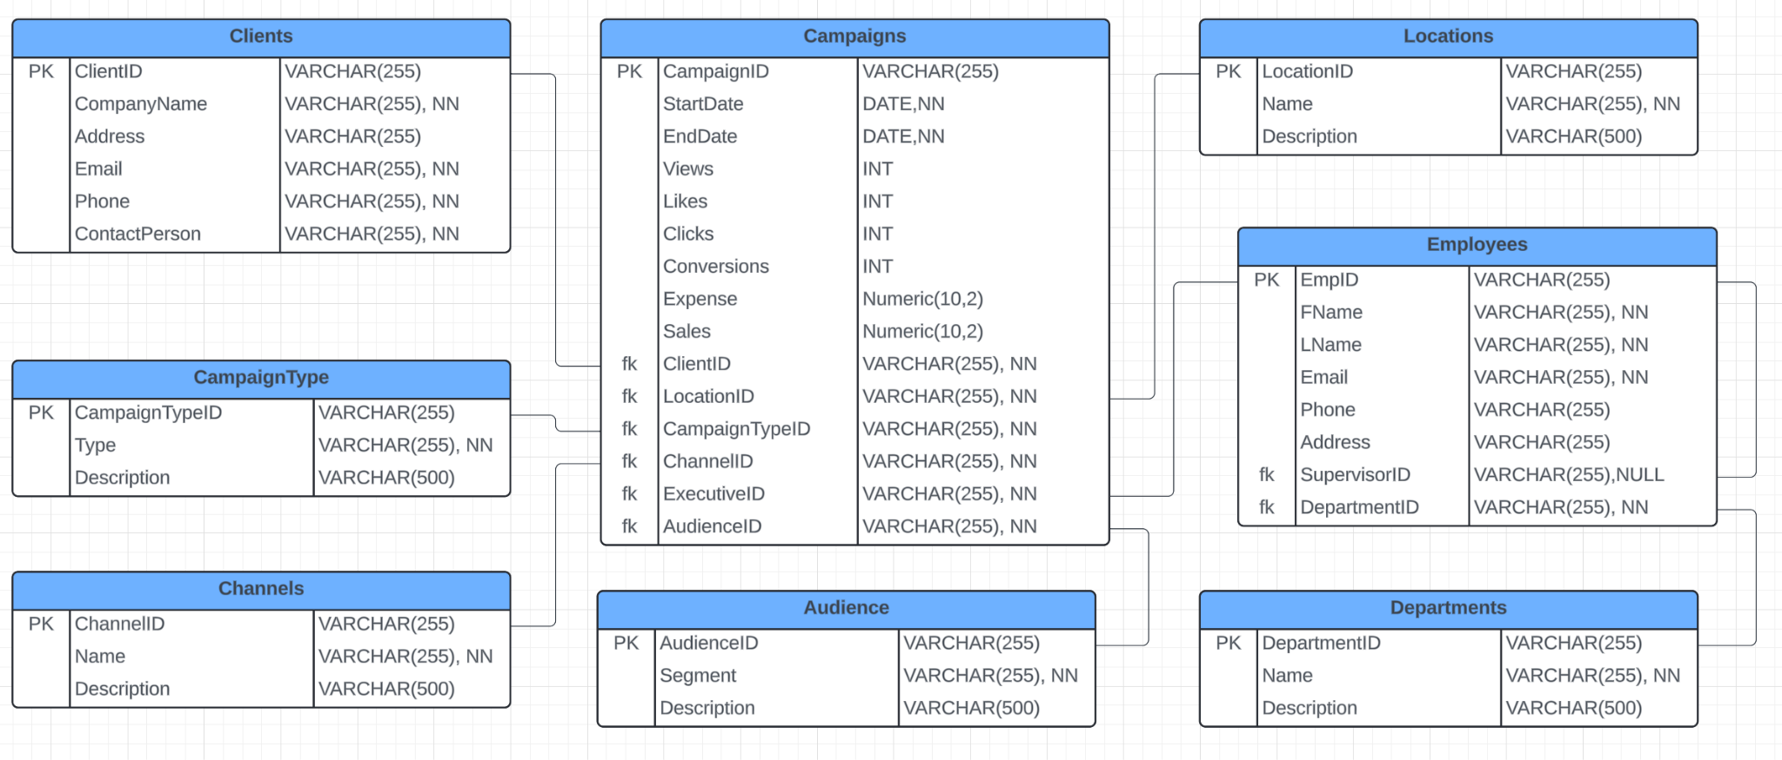
Functional ERD

Slide 5
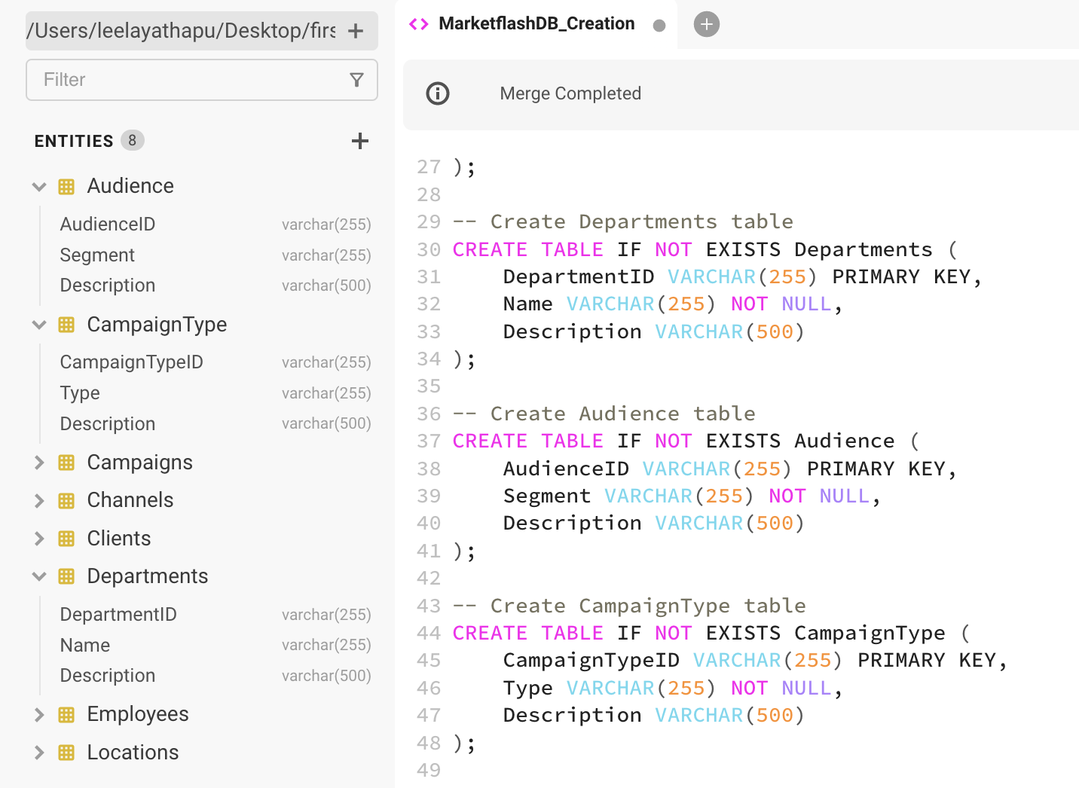
Database Creation in SQLite (Beekeeper Studio)

Slide 6
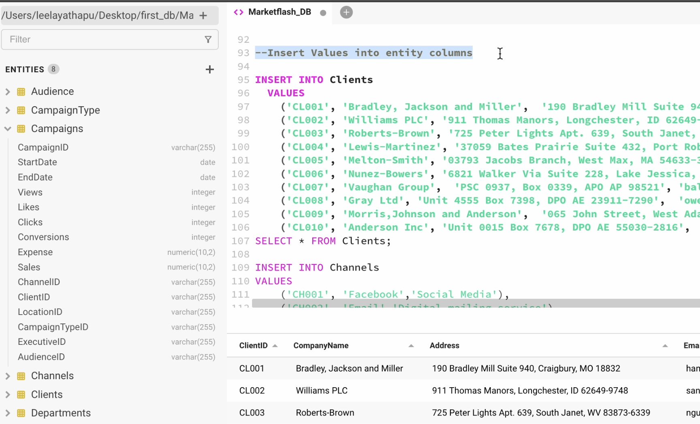
Populating Database and Design Validation
(Click on below image for video explanation and steps followed)

Slide 7
Data Preparation for Tableau
Data Cleanup
Streamline Data Preparation: During data preparation, hide intermediary columns that are used for calculations or transformations but are not needed in the final visualization.
Focus on Relevant Data: Hiding irrelevant columns help to focus on cleaning and preparing only the data that will be used in analysis.

Slide 8
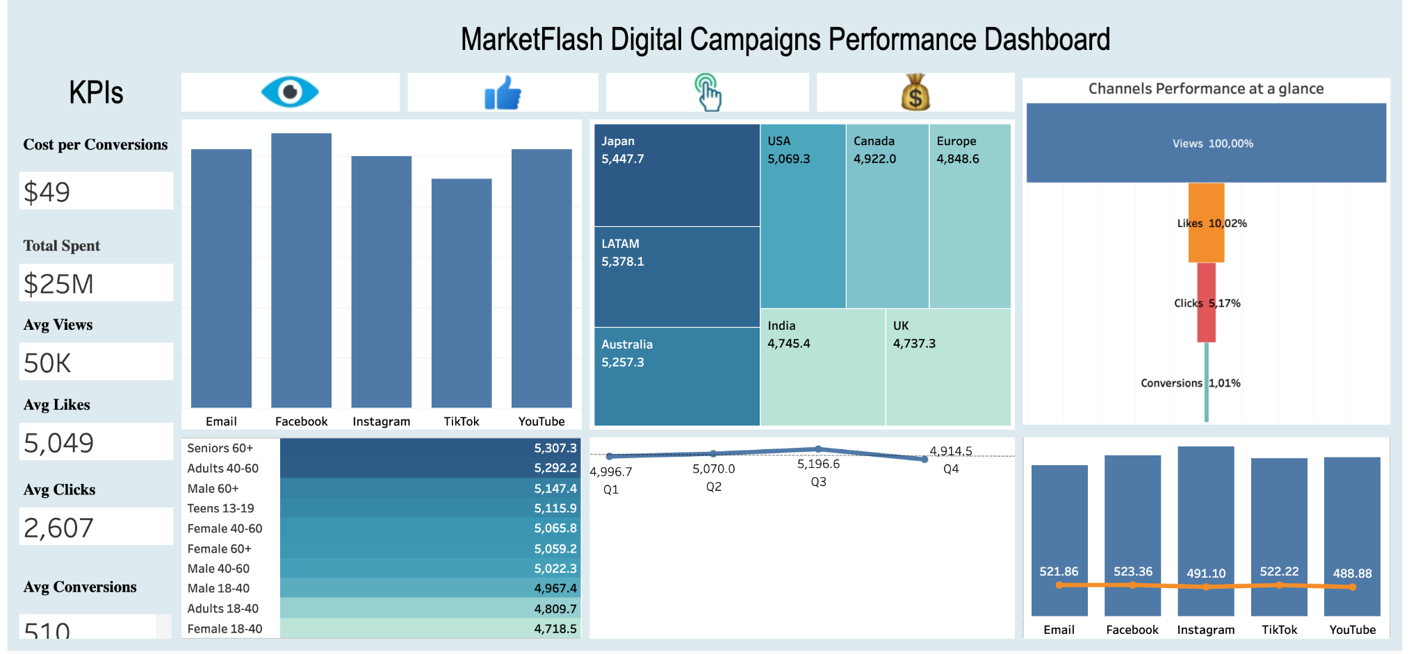
Marketfalsh Dashboard

Slide 9

Project Links
Project Deliverables: https://drive.google.com/drive/folders/11ZwxpnRLSsRpgrnKzXKoDIanIhjLRNKI?usp=sharing
DB Design : https://docs.google.com/document/d/1j6NR5byhaV-MKDt6FrhqNQFQCd3MnDasvUKKzQevimw/edit
DB creation and Validation: https://docs.google.com/document/d/1m4HJ6zSFLysJpk8brf4QilIkJEkkUIUqPfr41GX4Y8A/edit
DB at work (video link): https://drive.google.com/file/d/1U3G5dfCsy1w3VtXSMMCtVz1A4tIi-0wA/view?usp=sharing
SQL extra challenge: https://docs.google.com/document/d/1Fpmu3xPWw6Z5kpH_wURncwIzTC64k01N3KM3VHTcxsg/edit
Dashboard (Tableau public): https://public.tableau.com/views/MarketFlash_17230063583140/MainDashboard?:language=en-GB&:sid=&:redirect=auth&:display_count=n&:origin=viz_share_link
Presentation link:
https://drive.google.com/file/d/1iLg9LoUsgYKSBfpRCQgRDWLKggr60RTd/view?usp=drive_link

Slide 10


Kamal Kaur
Leela Reddy Yathapu
Ardita Abazi
Nina Ojike
Kshitija Angaluri

